Slide 1
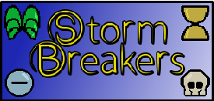
Iteration Report #2

Slide 2
Team Storm
Brett Blackstock - Project Leader, Lead Programmer
Michael Krause - Project Manager, Lead Narrative
Charlie Brown - Narrative / Utility
Wade Hetland - Narrative / Utility
Rachel Groth - Programmer
David Enersen - Lead Artist
Quincton Rush - 2D Artist
Skyler Wittmer - 2D Artist
Garrett Verhoeven - Contract Sound Designer

Slide 3
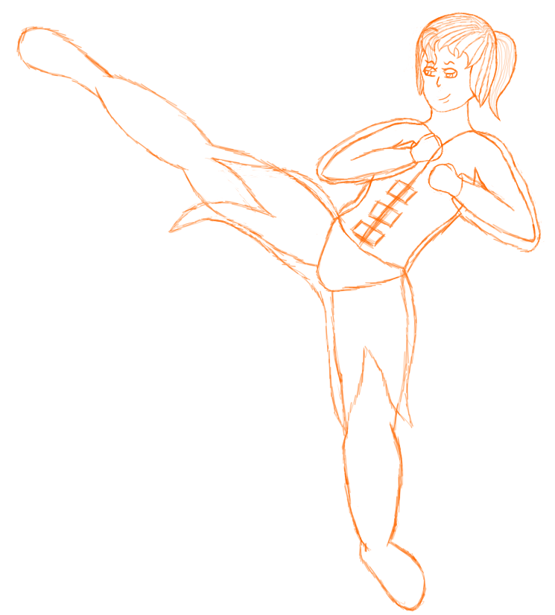
Character Concept Art
In process of defining style and feel

Slide 4
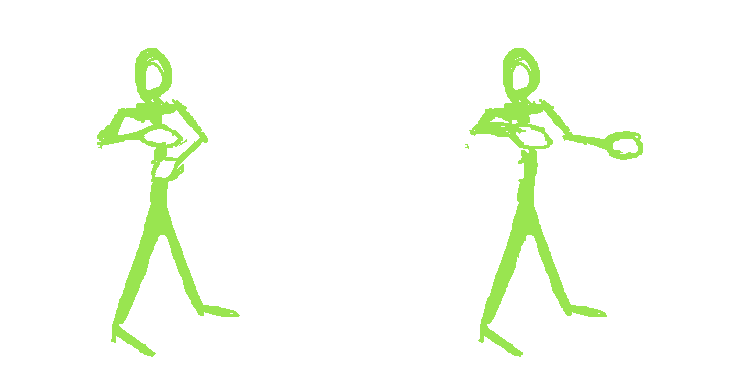
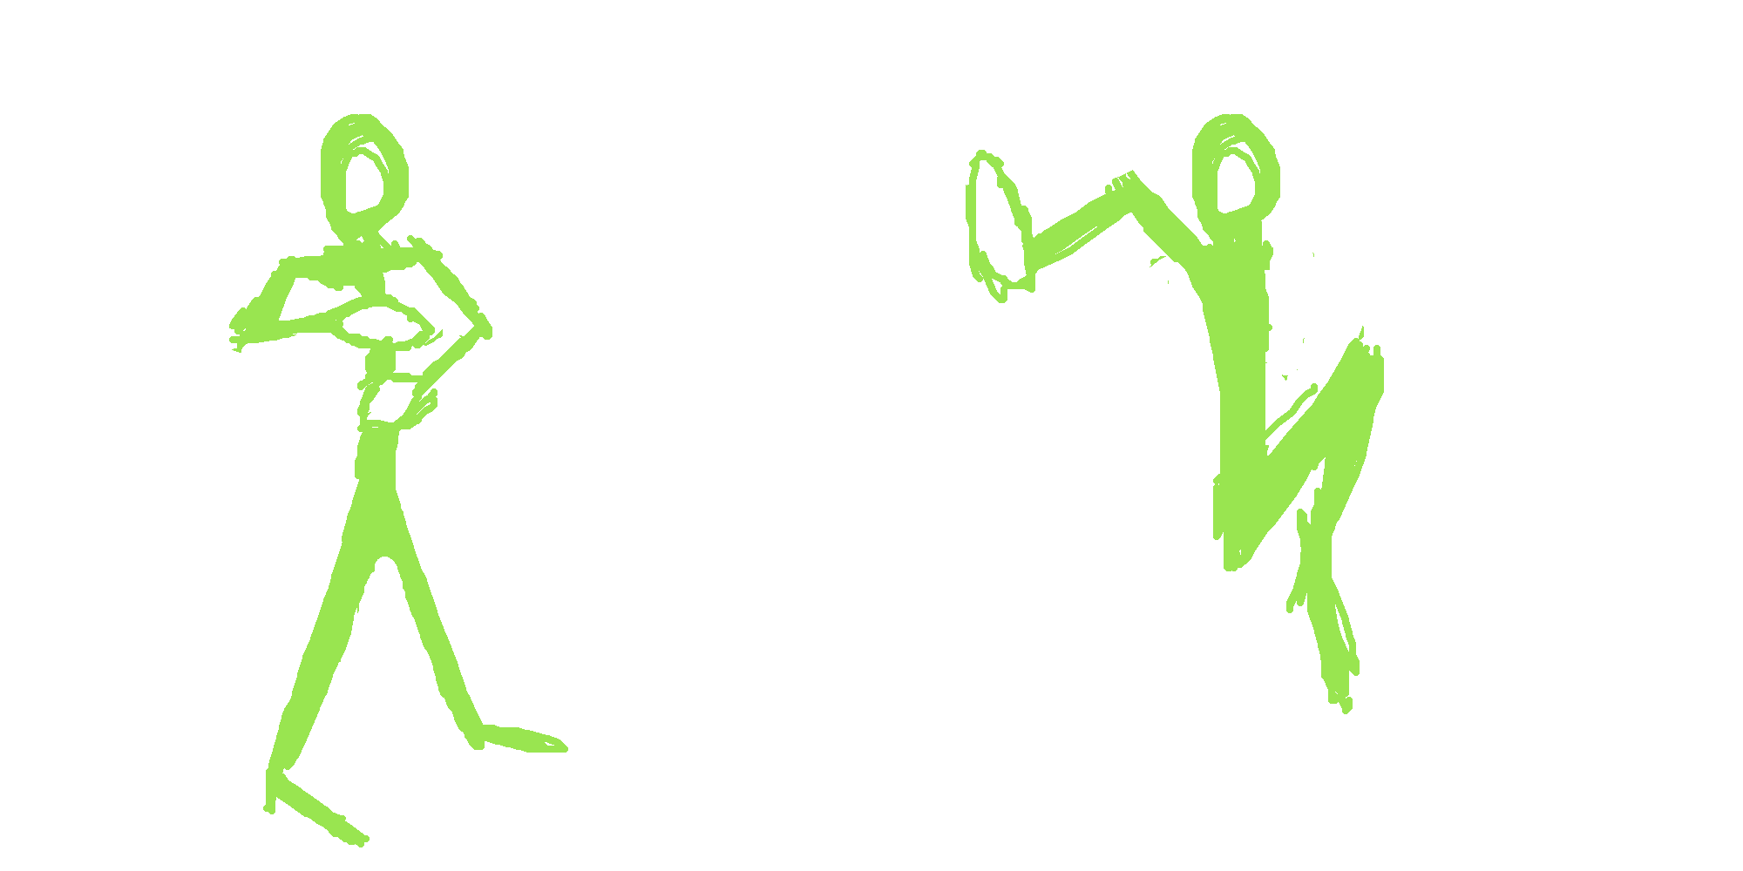
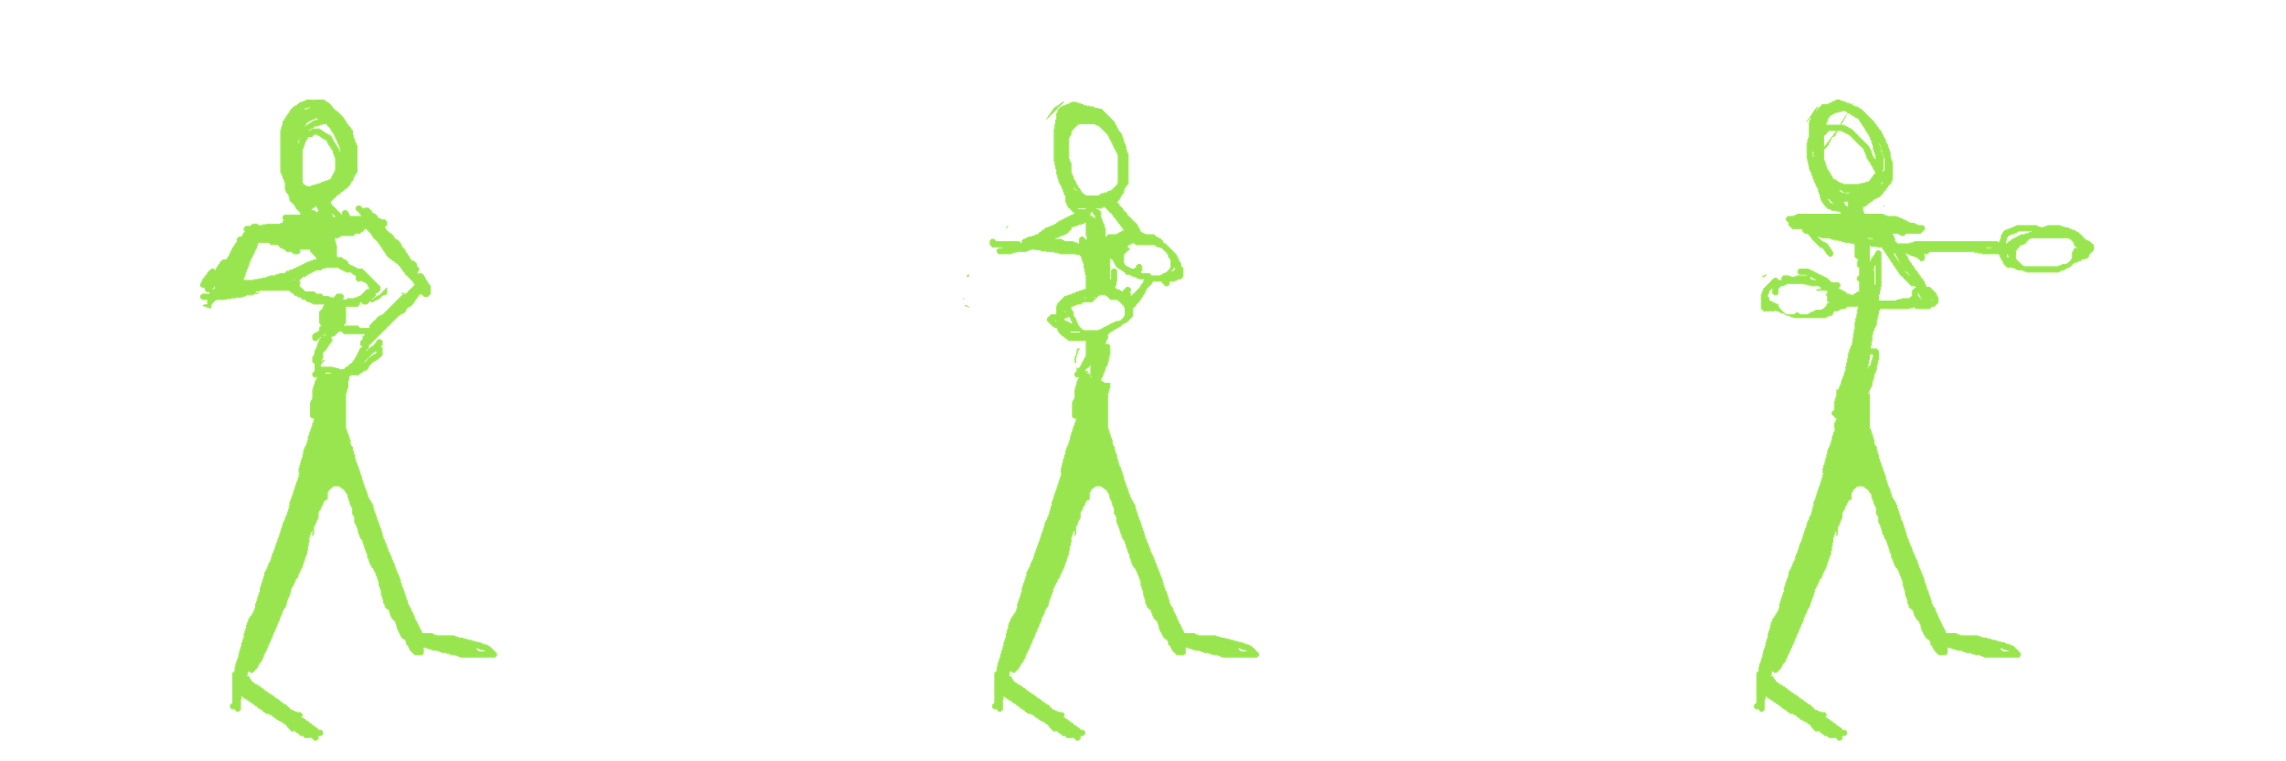
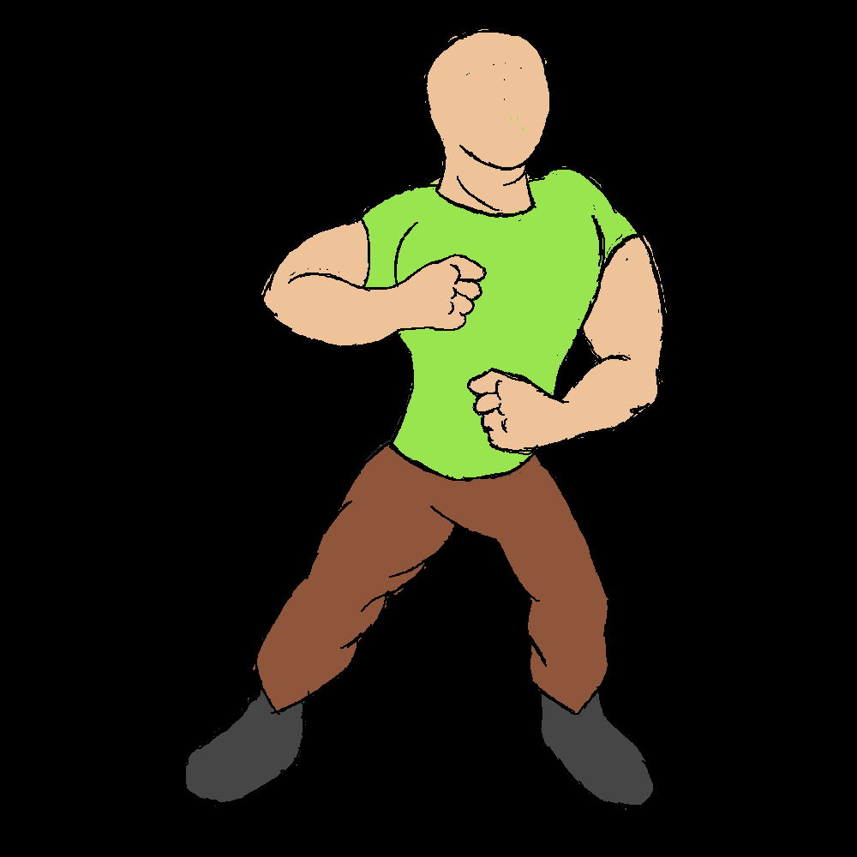
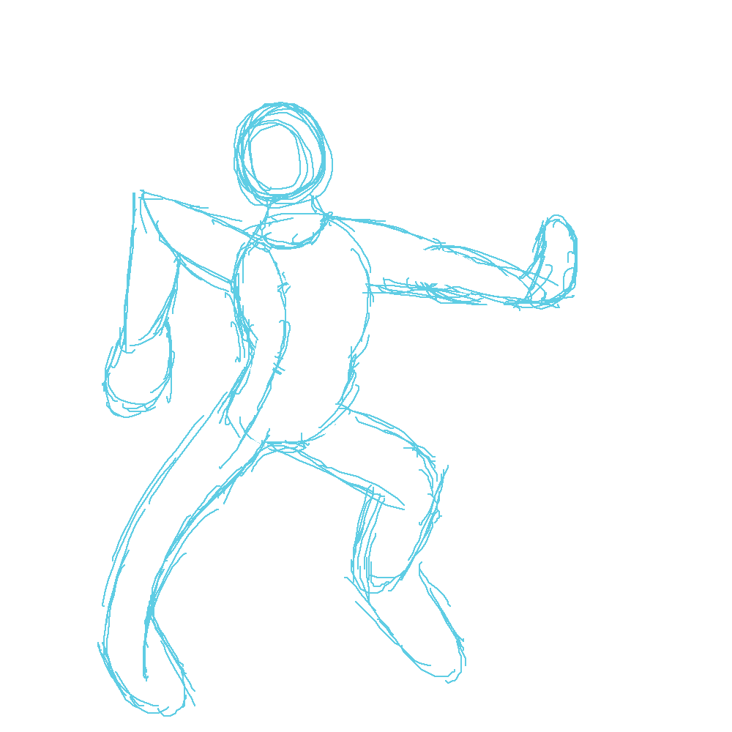
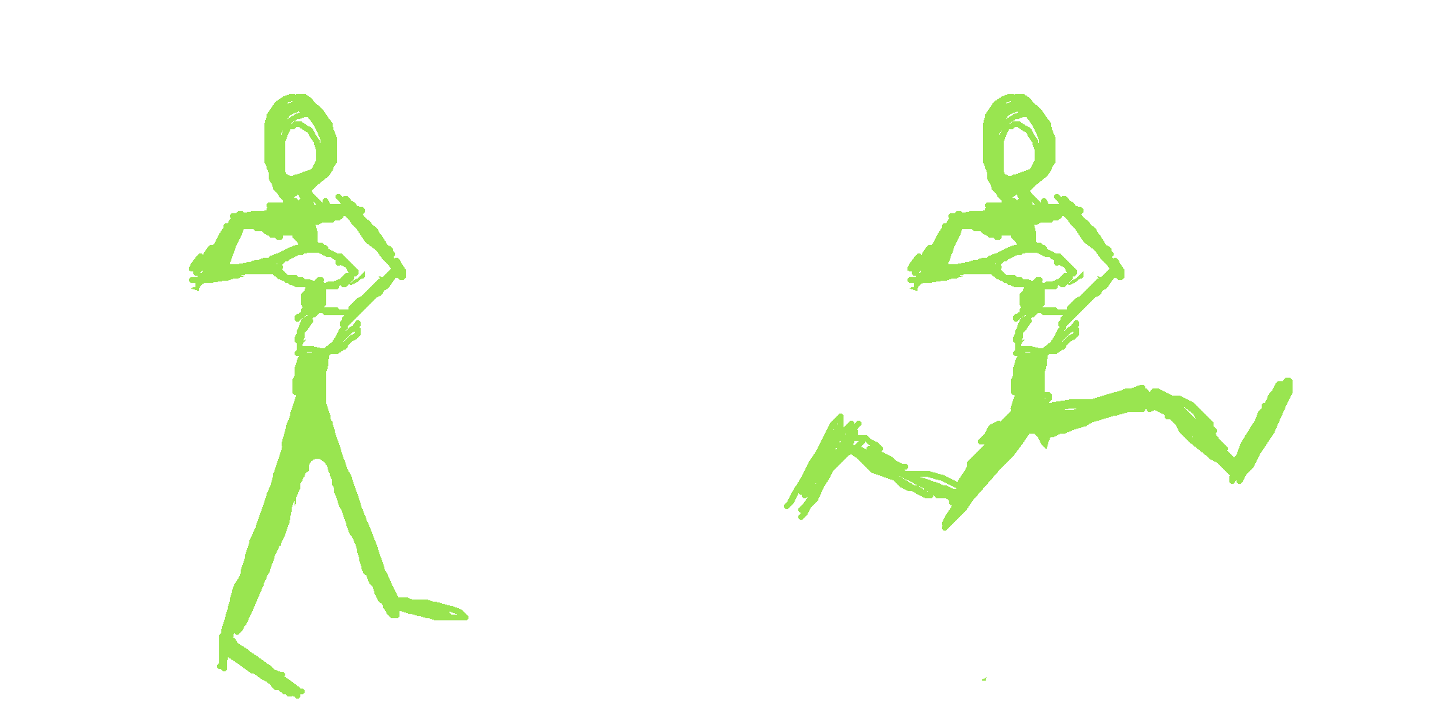
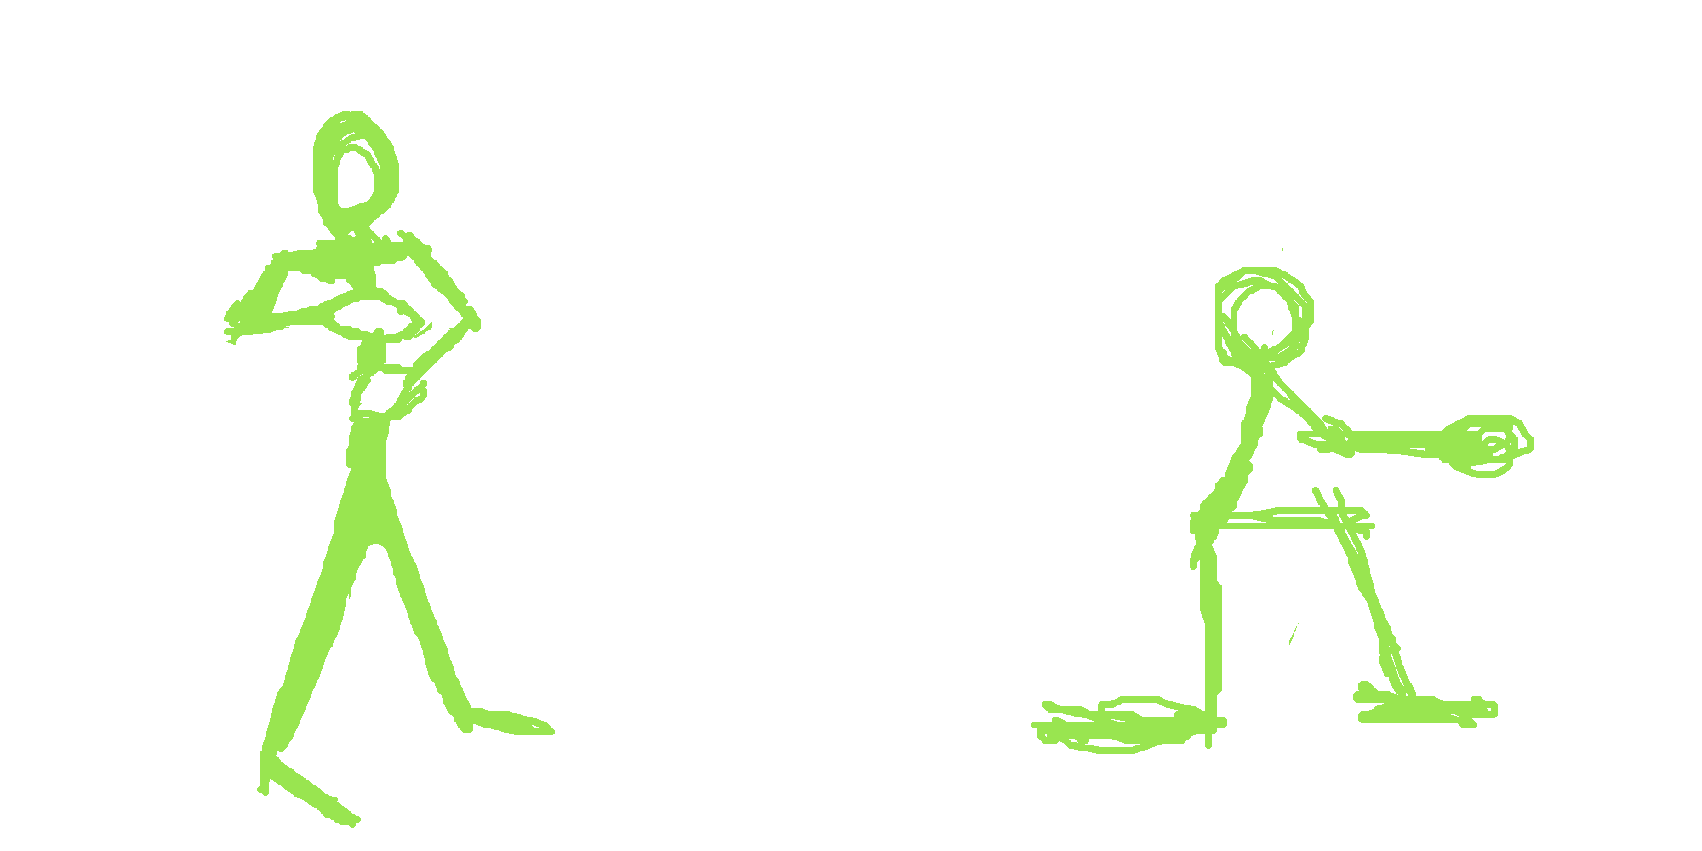


Animations

Slide 5
Programming so far
Movement
Basic Attack
Health
Animations
Rapid Prototyping
Menu

Slide 6
Rapid Prototyping
One frame animations
Quick and simple
Show concepts

Slide 7
Narrative
Symbols
Paper Prototype
Potential Storymode
Notes:
Artists - Skyler

Slide 8
Audio
Basic SFX
Have concept song made (Thanks Garrett!)

Slide 9
Trello Cards
Unity Tutorials for Menus
Basic health and damage
Basic movement
Look for inspiration in other religions for character design
Continue iterating on paper prototype
Brainstorm ways to show Randolf’s connection to the keepers
Make characters face towards each other
Prototype Randolph Moves
Create a document outlining a potential “story” mode
Brainstorm alternate game titles
Program last moves to interpret
Finalize symbols for the elements
Design game titlecard/logo
Implement initial dummy animations
Interpret some attack
Lynne Concept Art

Slide 10
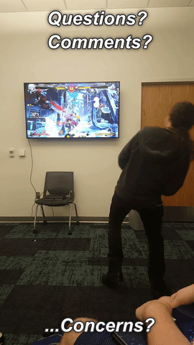
Questions? Comments?

